Slide 1

Chapter 4

Slide 2

Best-first search
  Greedy best-first search
  A* search
Heuristics
Local search algorithms
  Hill-climbing search
  Genetic algorithms
  Constraint satisfaction algorithms

Slide 3

\input{\file{algorithms}{tree-search-short-algorithm}}
A search strategy is defined by picking the order of node expansion

Slide 4

Idea: use an evaluation function f(n) for each node
  estimate of "desirability“
  Expand most desirable unexpanded node
Implementation:
Order the nodes in fringe in decreasing order of desirability
Special cases:
  greedy best-first search
  A* search

Slide 5



Slide 6

Evaluation function f(n) = h(n) (heuristic)= estimate of cost from n to goal
e.g., h_{SLD}(n) = straight-line distance from n to Bucharest
Greedy best-first search expands the node that appears to be closest to goal

Slide 7



Slide 8


Slide 9


Slide 10


Slide 11

Complete? No – can get stuck in loops, e.g., Iasi → Neamt → Iasi → Neamt →
Time? O(b^{m}), but a good heuristic can give dramatic improvement
Space? O(b^{m}) -- keeps all nodes in memory
Optimal? No

Slide 12

Idea: avoid expanding paths that are already expensive
h(n) = estimated cost from n to goal
f(n) = estimated total cost of path through n to goal
Evaluation function f(n) = g(n) + h(n)
g(n) = cost so far to reach n

Slide 13



Slide 14


Slide 15


Slide 16


Slide 17


Slide 18


Slide 19

8-puzzle problem
Block’s world problem
Graph coloring problem?
Heuristics?

Slide 20
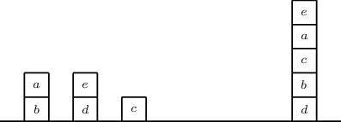


Slide 21
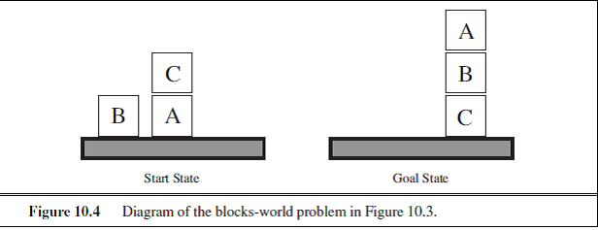

Slide 22

Definition- Approximation of estimation of cost of current node to goal node.

Slide 23

A heuristic h(n) is admissible if for every node n,
h(n) ≤ h*(n), where h*(n) is the true cost to reach the goal state from n.
An admissible heuristic never overestimates the cost to reach the goal, i.e., it is optimistic
Example: h_{SLD}(n) (never overestimates the actual road distance)

Slide 24


A heuristic is consistent if for every node n, every successor n' of n generated by any action a,
h(n) ≤ c(n,a,n') + h(n')
If h is consistent, we have
f(n') = g(n') + h(n')
= g(n) + c(n,a,n') + h(n')
≥ g(n) + h(n)
= f(n)
i.e., f(n) is non-decreasing along any path.
If h(n) is consistent, A* using GRAPH-SEARCH is optimal

Slide 25

Complete? Yes (unless there are infinitely many nodes with f ≤ f(G) )
Time? Exponential
Space? Keeps all nodes in memory
Optimal? Yes

Slide 26

E.g., for the 8-puzzle:
h₁(n) = number of misplaced tiles
h₂(n) = total Manhattan distance
(i.e., no. of squares from desired location of each tile)
h₁(S) = ?
h₂(S) = ?

Slide 27
E.g., for the 8-puzzle:
h₁(n) = number of misplaced tiles
h₂(n) = total Manhattan distance
(i.e., no. of squares from desired location of each tile)
h₁(S) = ? 8
h₂(S) = ? 3+1+2+2+2+3+3+2 = 18

Slide 28

A problem with fewer restrictions on the actions is called a relaxed problem
The cost of an optimal solution to a relaxed problem is an admissible heuristic for the original problem
If the rules of the 8-puzzle are relaxed so that a tile can move anywhere, then h1(n) gives the shortest solution
If the rules are relaxed so that a tile can move to any adjacent square, then h2(n) gives the shortest solution

Slide 29

Uses evaluation function
Evaluation measures distance from goal state
One problem can have multiple different evaluation functions
The key component of evaluation functions is heuristic function.

Slide 30

  Experience-based techniques for problem solving, learning, and discovery
  Generally used where the exhaustive search is impractical.
  Speeds up the process of finding a satisfactory solution via mental shortcuts to ease the cognitive load of making a decision.

Slide 31

In heuristic function, additional knowledge of problem is imparted to the search algorithm.
Use heuristic function that associates a value to each state.
This value computed by applying heuristic function on the state.
This makes one non goal state is more promising than the other one.

Slide 32

Heuristic value
Goal oriented search
Increases efficiency
Not optimal always
Solution in bounded time

Slide 33

Heuristics are rules of thumb, do not guarantee for a solution to a problem.
Can be effective if applied correctly, require domain specific information
Heuristic search function estimates cost from current state to goal, presuming function is efficient.

Slide 34

Heuristic search
Blind search
Only have knowledge about already explored nodes
No knowledge about how far a node is from goal state
Estimates “distance” to goal state
Guides search process toward goal state
Prefers states that lead close to and not away from goal state

Slide 35

8 Puzzle problem
Heuristic Function:
Count the number of tiles that
are in place.
H. value for goal state : 8

Slide 36

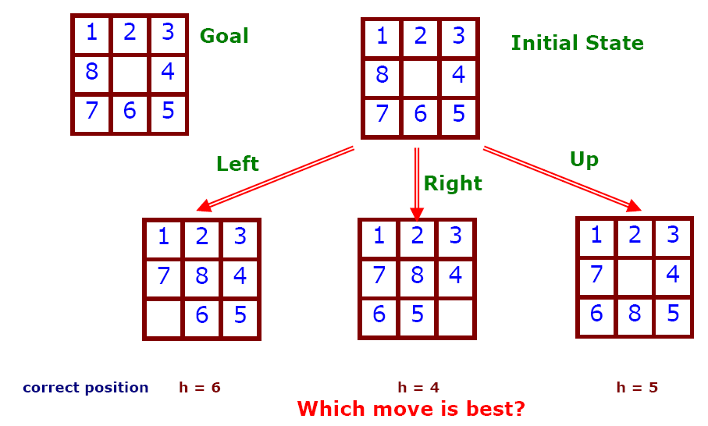

Slide 37
Apply the Heuristic : different approaches
Count correct position of each tile, compare to goal state
Count incorrect position of each tile, compare to goal state
Count how far away each tile is from it’s correct position.

Slide 38
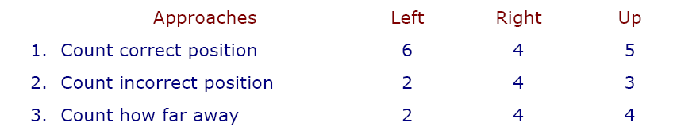

Slide 39

Heuristic function:
No. of possible wins for you minus no of possible wins for opponents

Slide 40

Best First Search
A* search
IDA*
Local search algorithms
  Hill Climbing
  Simulated annealing
  Genetic algorithms

Slide 41


Slide 42
f(N) = h(N), with h(N) = Manhattan distance to the goal
(not A*)
8
7
6
5
4
3
2
3
4
5
6
7
5
4
3
5
6
3
2
1
0
1
2
4
7
6
5
8
7
6
5
4
3
2
3
4
5
6

Slide 43
f(N) = h(N), with h(N) = Manhattan distance to the goal
(not A*)
8
7
6
5
4
3
2
3
4
5
6
7
5
4
3
5
6
3
2
1
0
0
1
2
4
7
7
6
5
8
7
6
5
4
3
2
3
4
5
6

Slide 44
f(N) = g(N)+h(N), with h(N) = Manhattan distance to goal (A*)
8+3
8+3
7+4
7+4
6+5
6+3
5+6
5+6
4+7
4+7
3+8
3+8
2+9
8
7
6
5
4
3
2+9
3+10
2
3
4
5
6
7+2
7+2
5+6
4+7
3+8
7
5
4
3+8
3
5
6+1
2+9
6+1
2+9
1+10
1+10
0+11
6
3
2
1
0+11
0
1
2
4
7+0
7+0
6+1
7
6+1
6
5
8+1
8+1
7+2
7+2
6+3
6+3
5+4
5+4
4+5
4+5
3+6
3+6
2+7
8
7
6
5
4
3
2+7
3+8
2
3
4
5
6

Slide 45

In many optimization problems, the path to the goal is irrelevant; the goal state itself is the solution
Find configuration satisfying constraints, e.g., n-queens
In such cases, we can use local search algorithms
keep a single "current" state, try to improve it
State space = set of "complete" configurations

Slide 46

Hill Climbing
  Gradient Descent
  Steepest Ascent
Simulated annealing
Genetic algorithms

Slide 47


"Like climbing Everest in thick fog with amnesia"

Slide 48

Problem: depending on initial state, can get stuck in local maxima

Slide 49


h = number of pairs of queens that are attacking each other, either directly or indirectly
h = 17 for the above state

Slide 50

A local minimum with h = 1

Slide 51

Use heuristic to move only to states that are better than the current state.
Always move to better state when possible.
Always climb uphill whenever you can, without looking around.

Slide 52
Moves towards the goal
Using heuristic, it finds which direction to move.
It always find the node closer to the goal.
HCSA is a loop that continuously moves in the direction of increasing values.

Slide 53

Simple hill climbing:
First closer node is chosen
Steepest ascent/Gradient Descent hill climbing:
All the successors are compared, closest to the solution is chosen.

Slide 54

Will terminate when at local optimum.
The order of application of operators can make a big difference.
Can’t see past a single move in the state space.

Slide 55

Local Maxima:
It is a state which is better, all the other moves worsen the situation.
Plateau:
An area of the search space where evaluation function is flat, thus requiring random walk.
Ridge:
Where there are steep slopes and the search direction is not towards the top but towards the side.

Slide 56

Local Maxima- Backtrack to some earlier node and try new direction
Plateau: Make a big jump or apply the operators again and again though the situation continues
Ridges: apply two or more operators before doing the test; will help in moving in several directions at once

Slide 57


